Slide 1
WP11: Improving the accuracy of aerosol light absorption determinations
PSI, CNRS, UU, TROPOS, JRC
IPTA-Demokritos
IDAEA-CSIC
TNO
ACTRIS-2 WP3, WP8 and WP11
Bologna, Italy
9-11 october

Slide 2
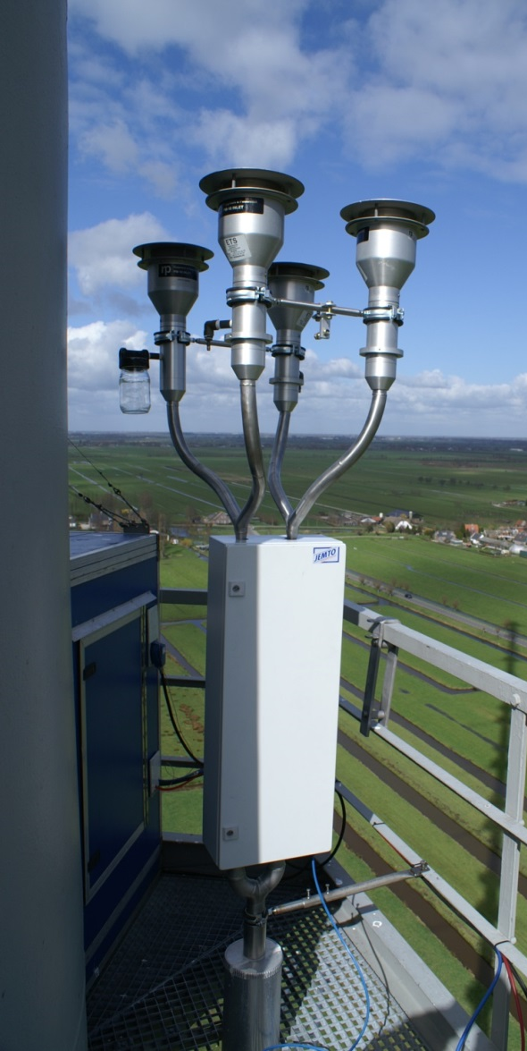
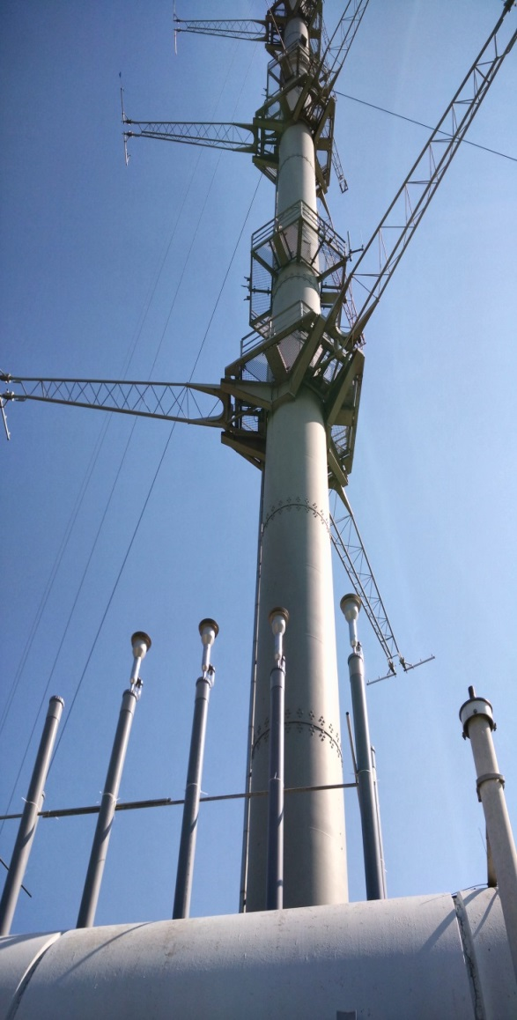
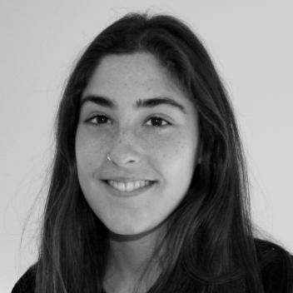
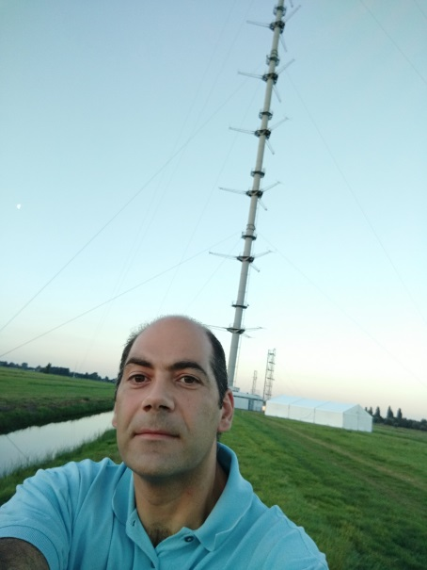
WP11: Task 1 In-situ closure (MAC) Cabauw Campaign sept-oct 2016
Rob
Marina
Prodromos
ACTRIS-2 WP3, WP8 and WP11, Bologna, Italy, 9-11 October 2016

Slide 3
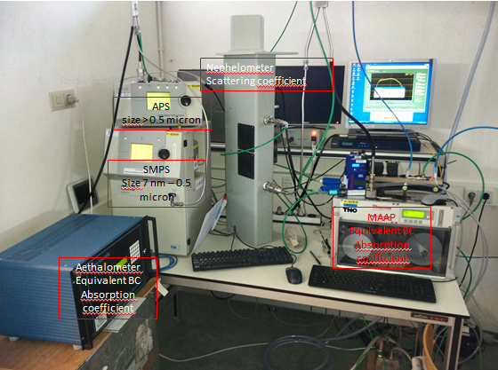
WP11: Task 1 In-situ closure (MAC) Cabauw Campaign sept-oct 2016
ACTRIS-2 WP3, WP8 and WP11, Bologna, Italy, 9-11 October 2016

Slide 4
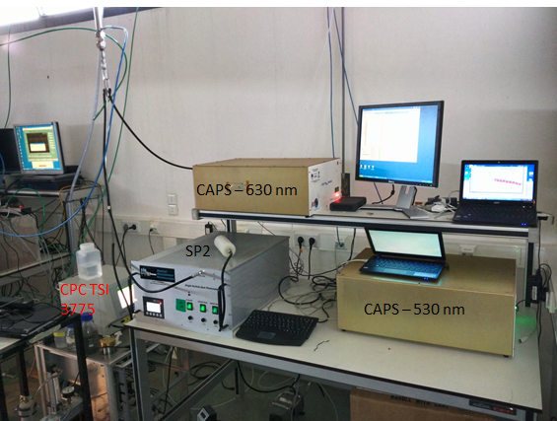
WP11: Task 1 In-situ closure (MAC) Cabauw Campaign sept-oct 2016
ACTRIS-2 WP3, WP8 and WP11, Bologna, Italy, 9-11 October 2016

Slide 5
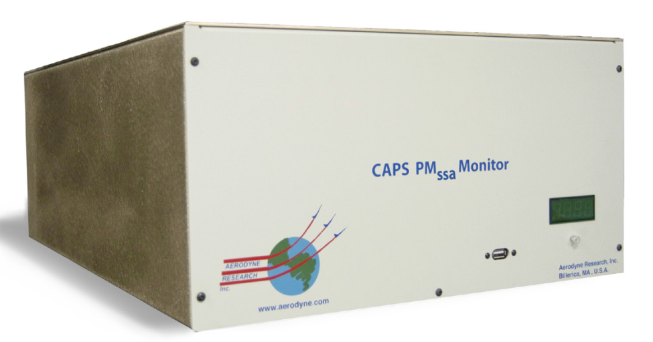
WP11: Task 1 In-situ closure (MAC) Cabauw Campaign sept-oct 2016
Extinction – Scattering = absorption
$$SSA= \frac{scattering}{extinction}$$
intracavity laser-induced particle incandescence
Size distribution used for trunc correct
Aerodynamic vs optical size
Spherical Mie particles vs T-Matrix
ACTRIS-2 WP3, WP8 and WP11, Bologna, Italy, 9-11 October 2016

Slide 6
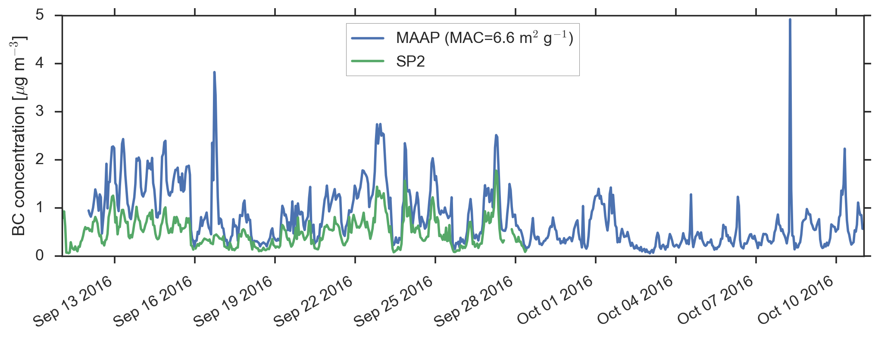
WP11: Task 1 In-situ closure (MAC) Cabauw Campaign sept-oct 2016
ACTRIS-2 WP3, WP8 and WP11, Bologna, Italy, 9-11 October 2016

Slide 7
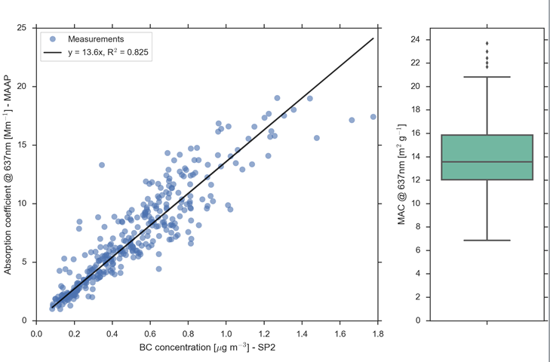
WP11: Task 1 In-situ closure (MAC) Cabauw Campaign sept-oct 2016
ACTRIS-2 WP3, WP8 and WP11, Bologna, Italy, 9-11 October 2016

Slide 8
WP11: Task 1 In-situ closure (MAC) Cabauw Campaign sept-oct 2016
TNO
ACTRIS-2 WP3, WP8 and WP11, Bologna, Italy, 9-11 October 2016

Slide 9
WP11: Task 1 In-situ closure (MAC) Cabauw Campaign sept-oct 2016
Work1: Absorption Coefficient
CAPS PMssa absorption relies on accurate truncation correction of the scattering data. Possible focus of future study:
How important is the truncation correction? (CAPS PMssa scattering vs nephelometer)
Compare different methods of calculating truncation correction (scattering phase functions, cell geometry)
Work2: Mass concentration
SP2 and EC from EUSAAR sampling train.
ACTRIS-2 WP3, WP8 and WP11, Bologna, Italy, 9-11 October 2016

Slide 10
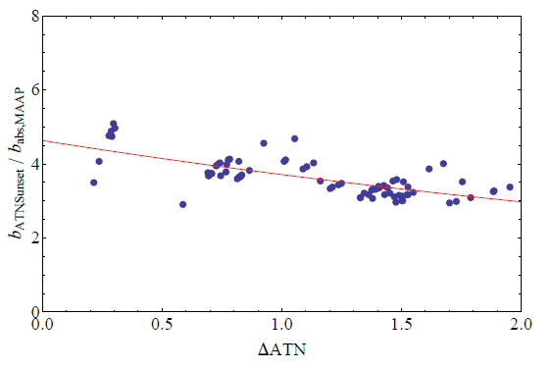
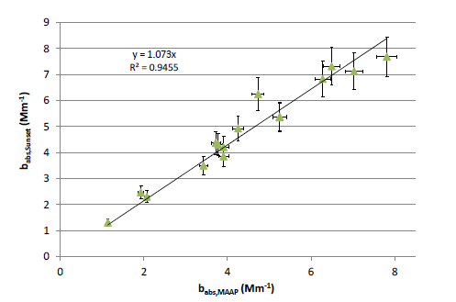
WP11: Task 1 In-situ closure (MAC) Cabauw Campaign sept-oct 2016
Work3: MAAP and Aethalometer
CAPS PMssa 630 nm and 530nm
7-lambda aethalometer + MAAP
Work4: Using EC/OC instr. as absorption photometer
ACTRIS-2 WP3, WP8 and WP11, Bologna, Italy, 9-11 October 2016

Slide 11
WP11: Task 1 In-situ closure (MAC) Cabauw Campaign sept-oct 2016
Work5: column closure
spectral absorption coefficient
Spectral scattering coefficient
Chemical composition
Well mixed boundary layer
Raman lidar data
Support MAX-DOAS aerosol validation
ACTRIS-2 WP3, WP8 and WP11, Bologna, Italy, 9-11 October 2016

Slide 12
WP11: Task 1 In-situ closure (MAC) Cabauw Campaign sept-oct 2016
A lot of work to do
ACTRIS-2 WP3, WP8 and WP11, Bologna, Italy, 9-11 October 2016

